Slide 1
Waterway-sunrise-i_655A

Slide 2
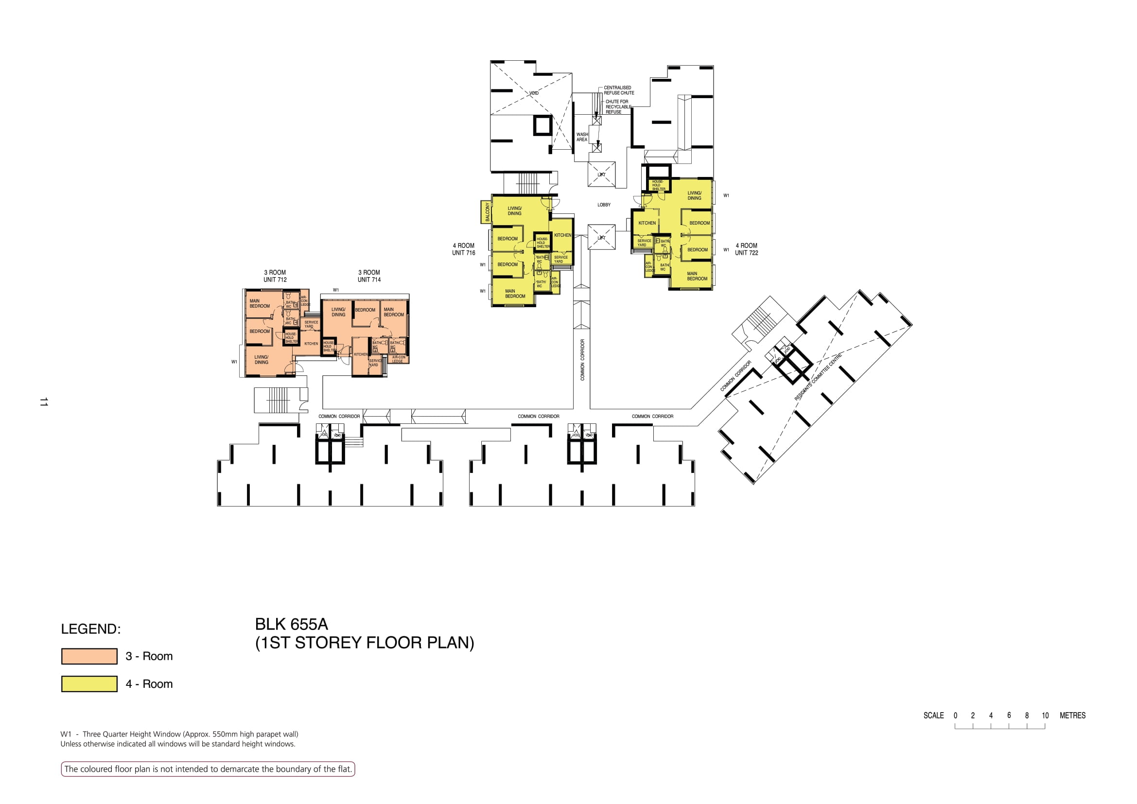

Slide 3
WASH AREA
LOBBY
716
722
712
714
COMMON CORRIDOR
COMMON CORRIDOR
COMMON CORRIDOR
COMMON CORRIDOR

Slide 4
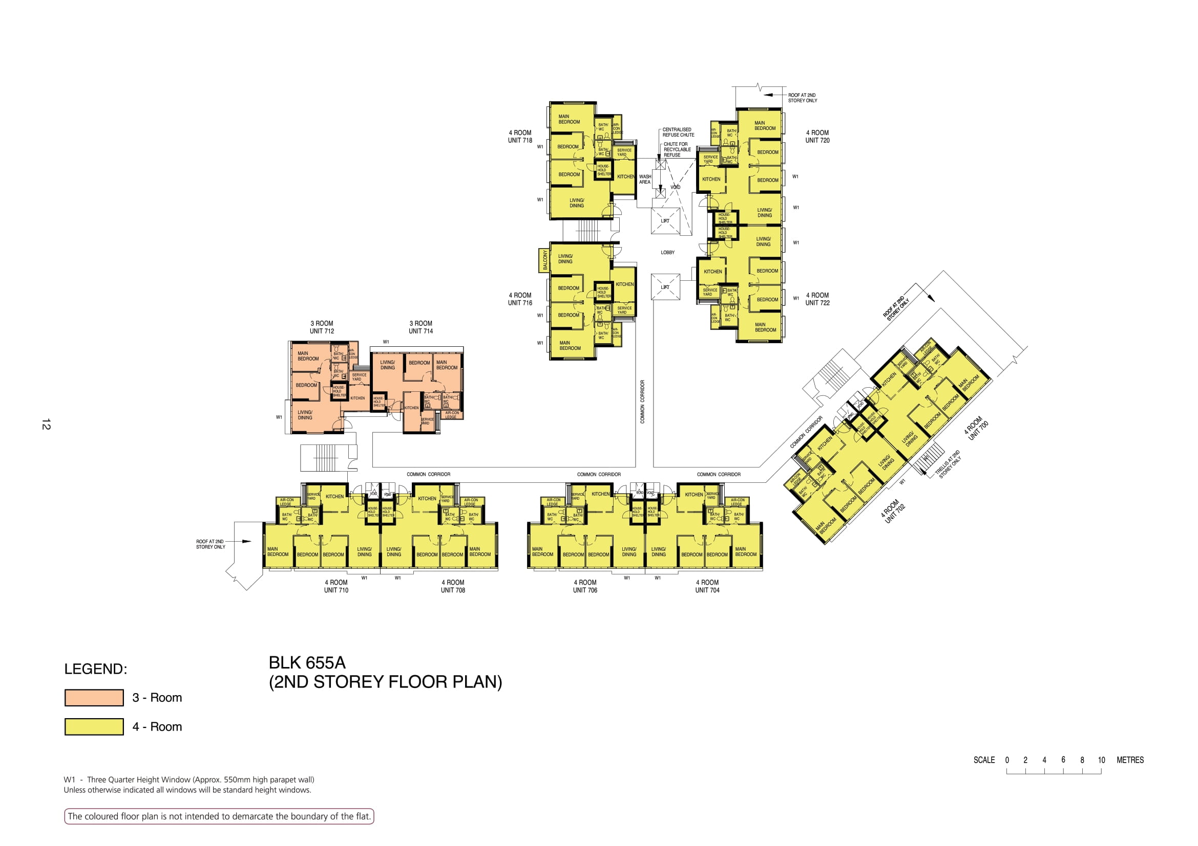

Slide 5
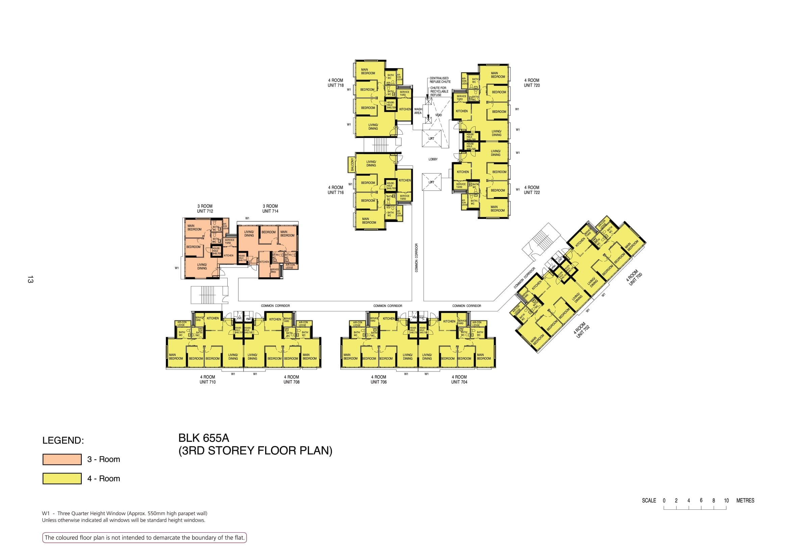

Slide 6
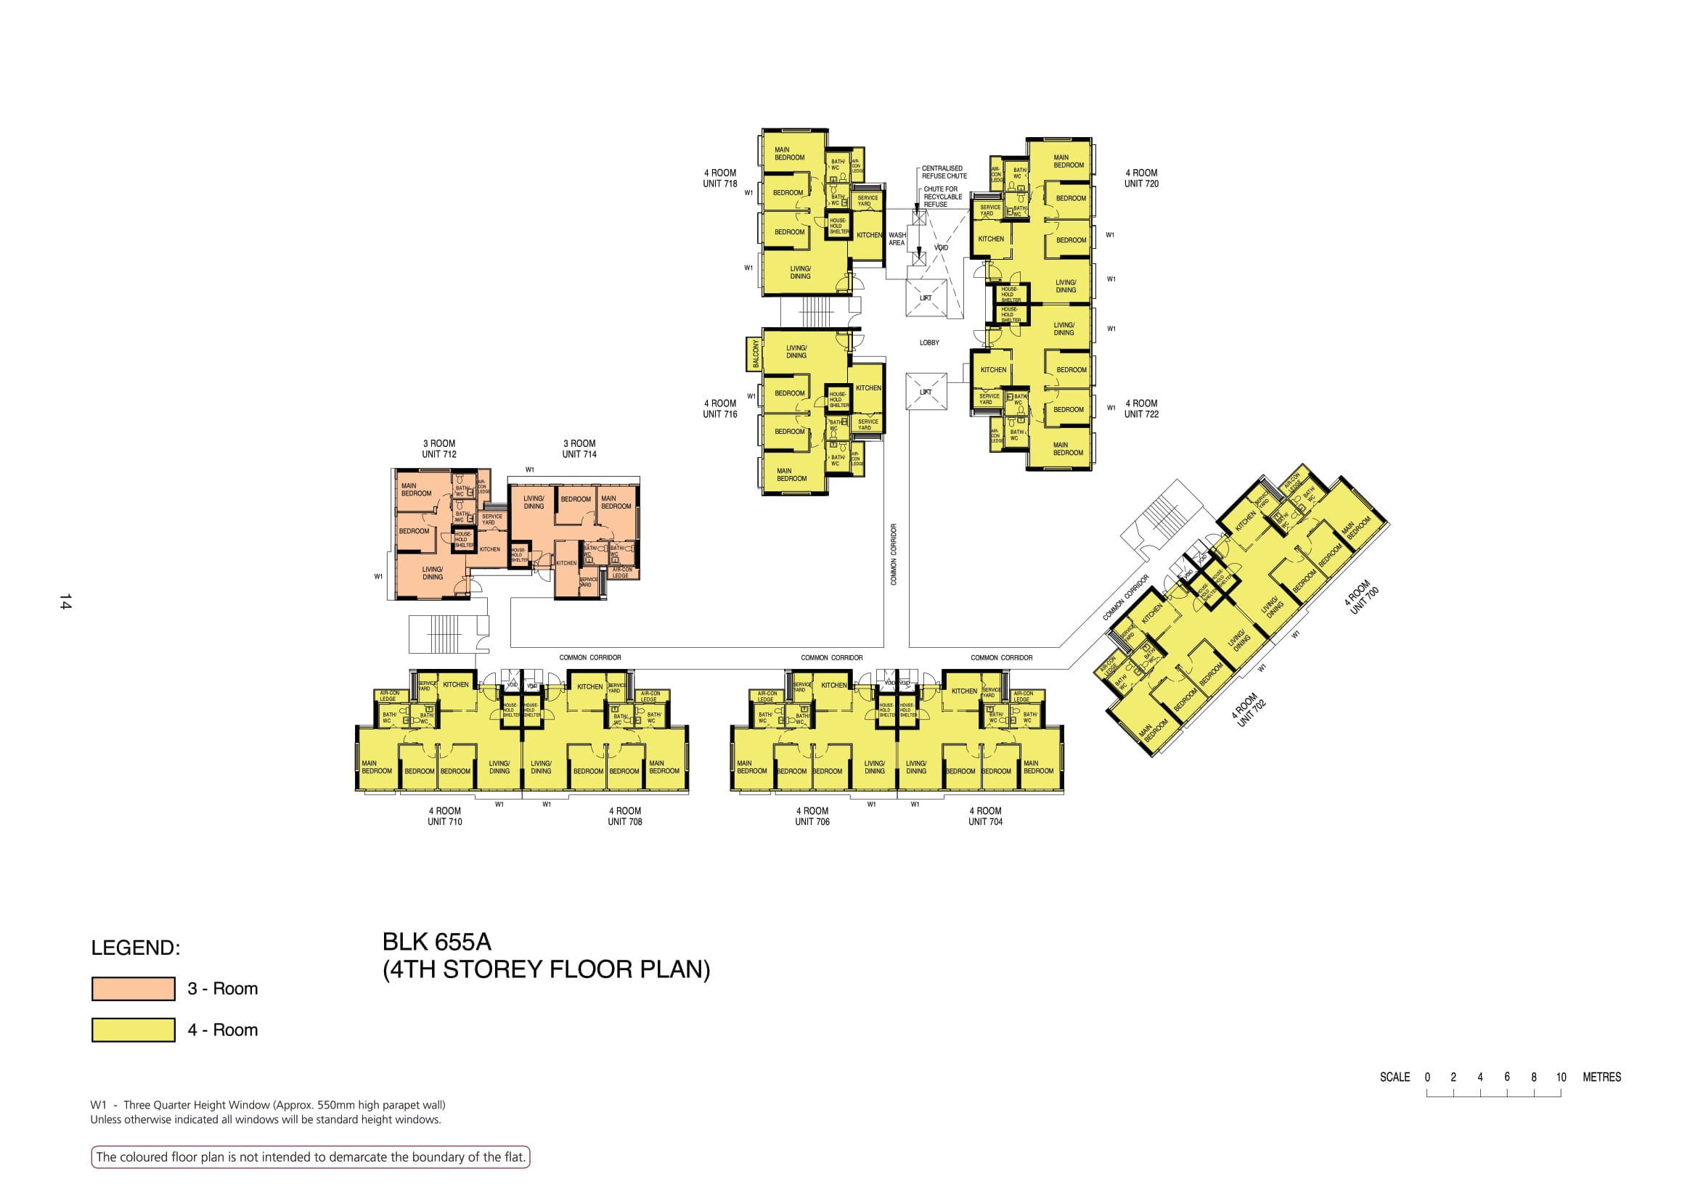

Slide 7
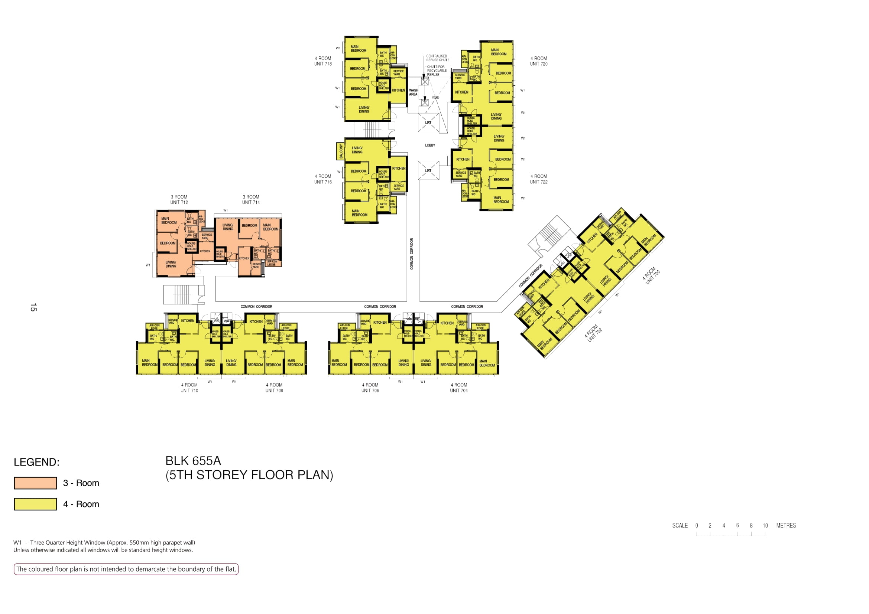

Slide 8
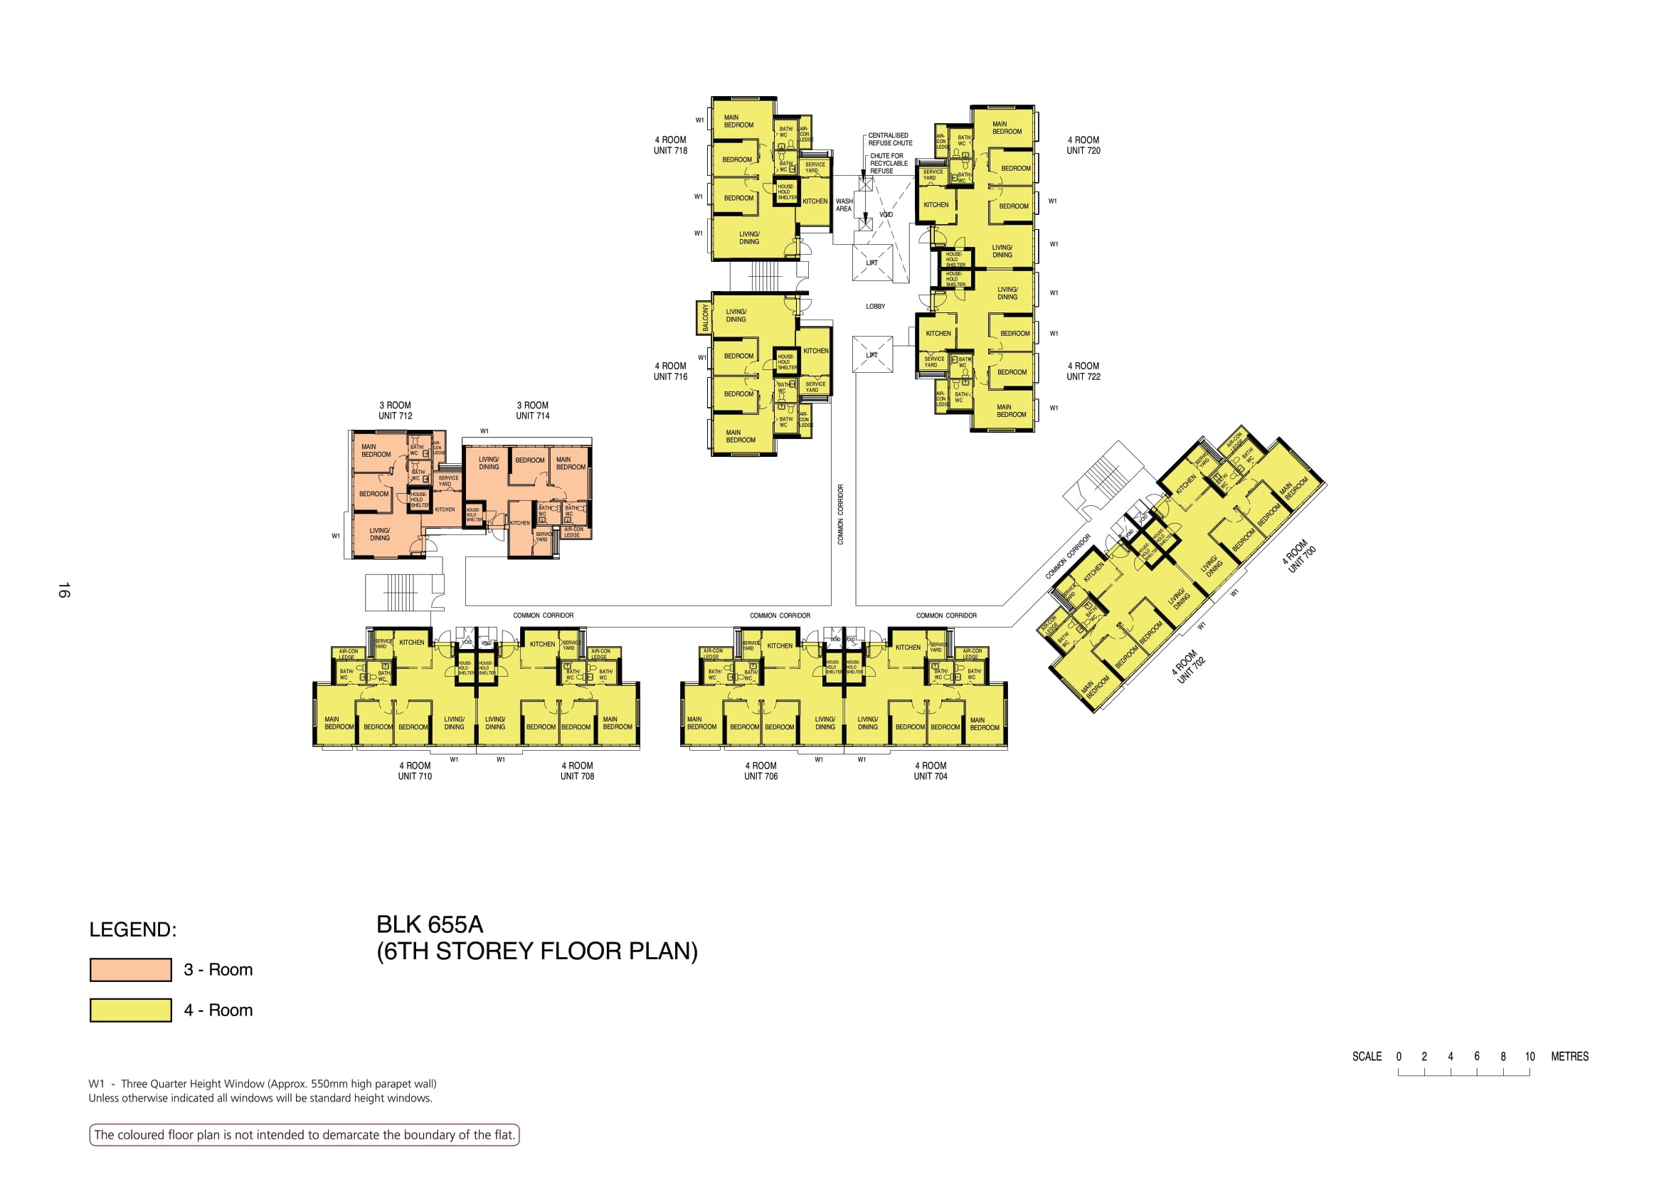

Slide 9
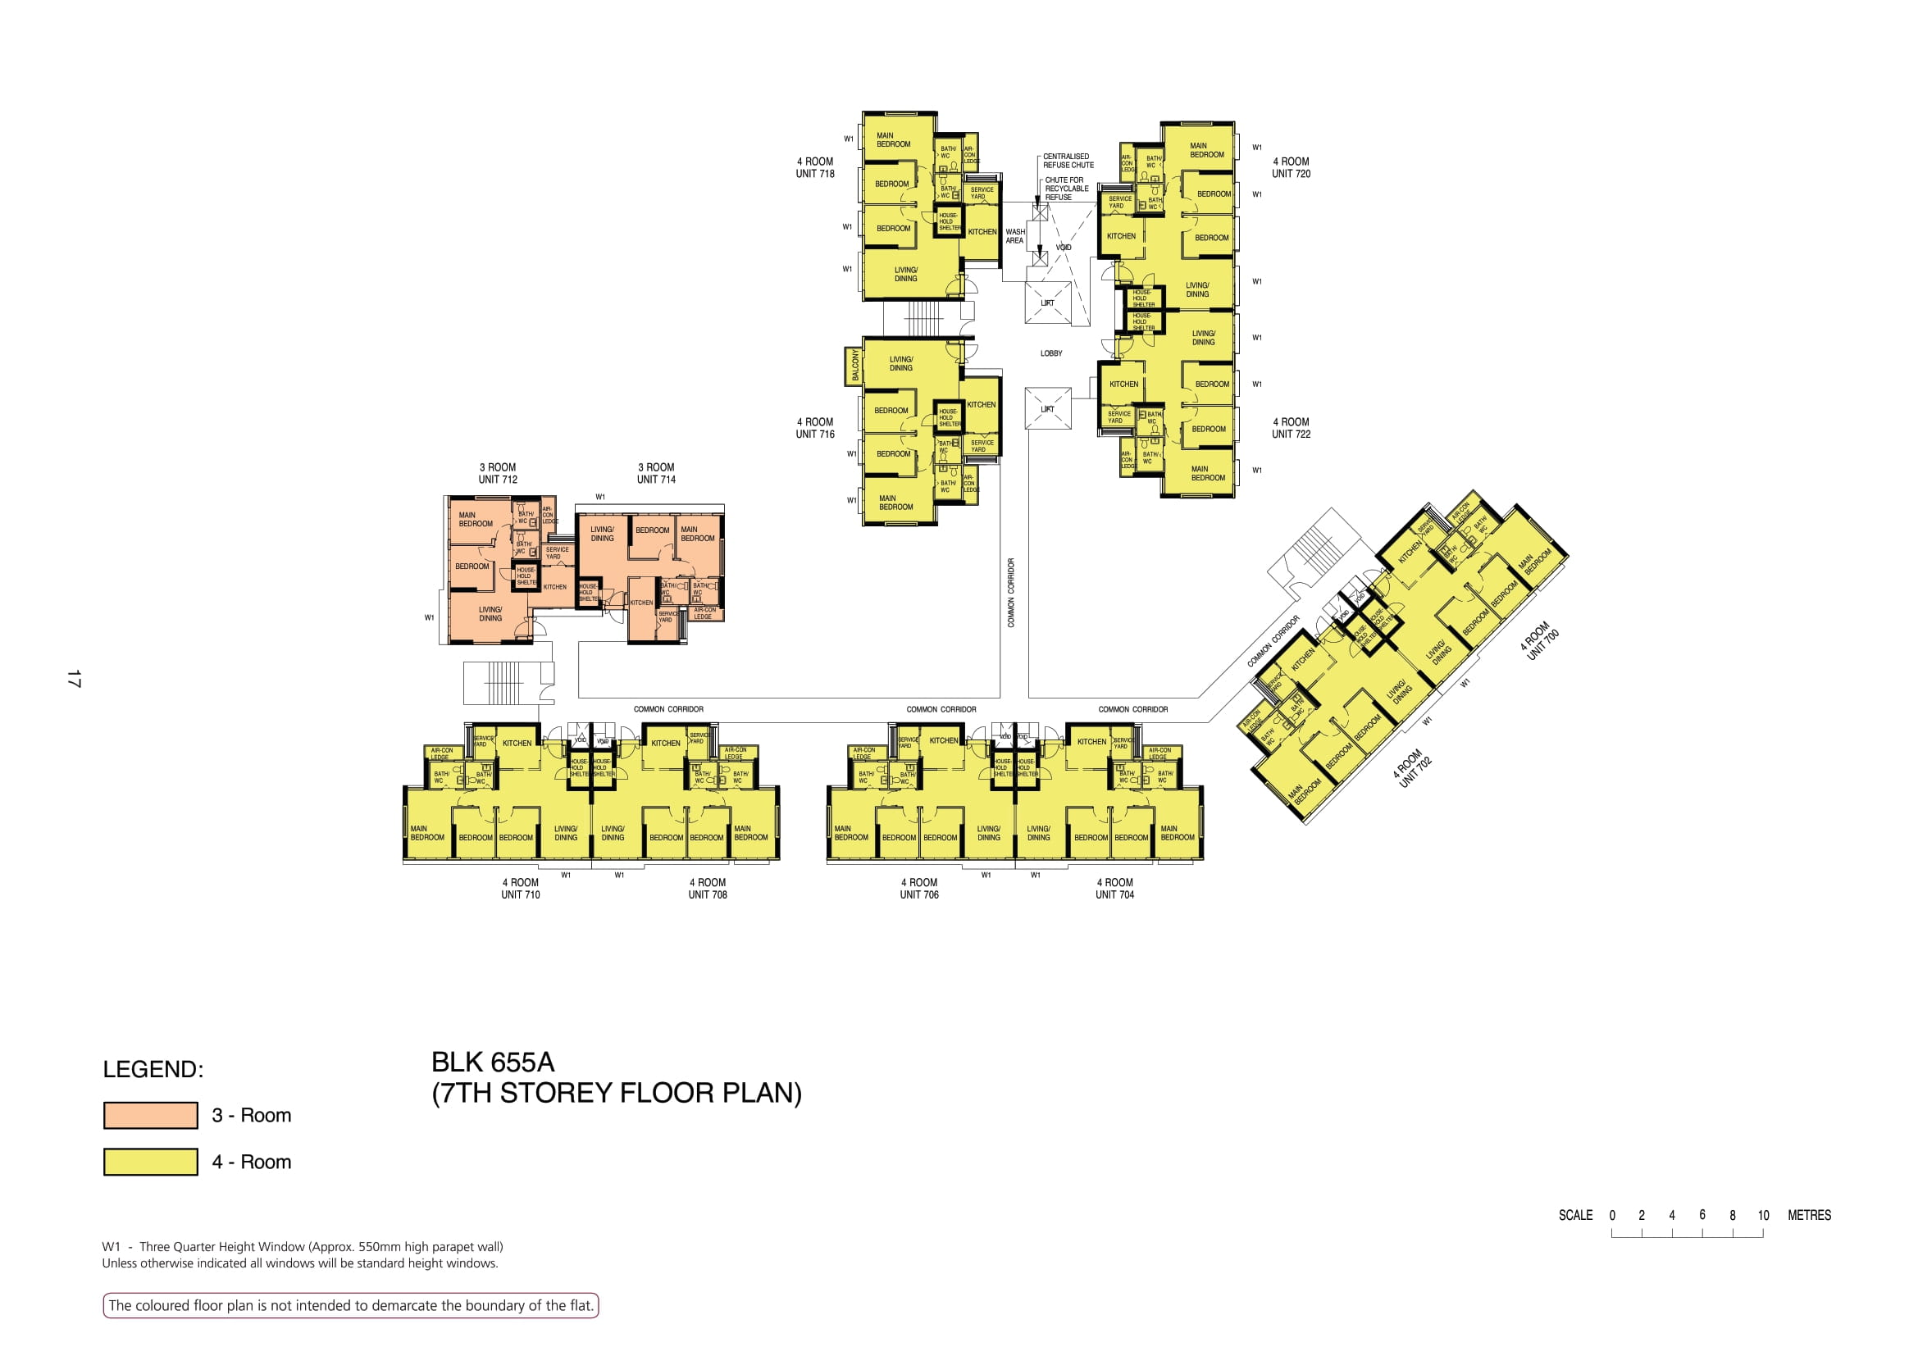

Slide 10
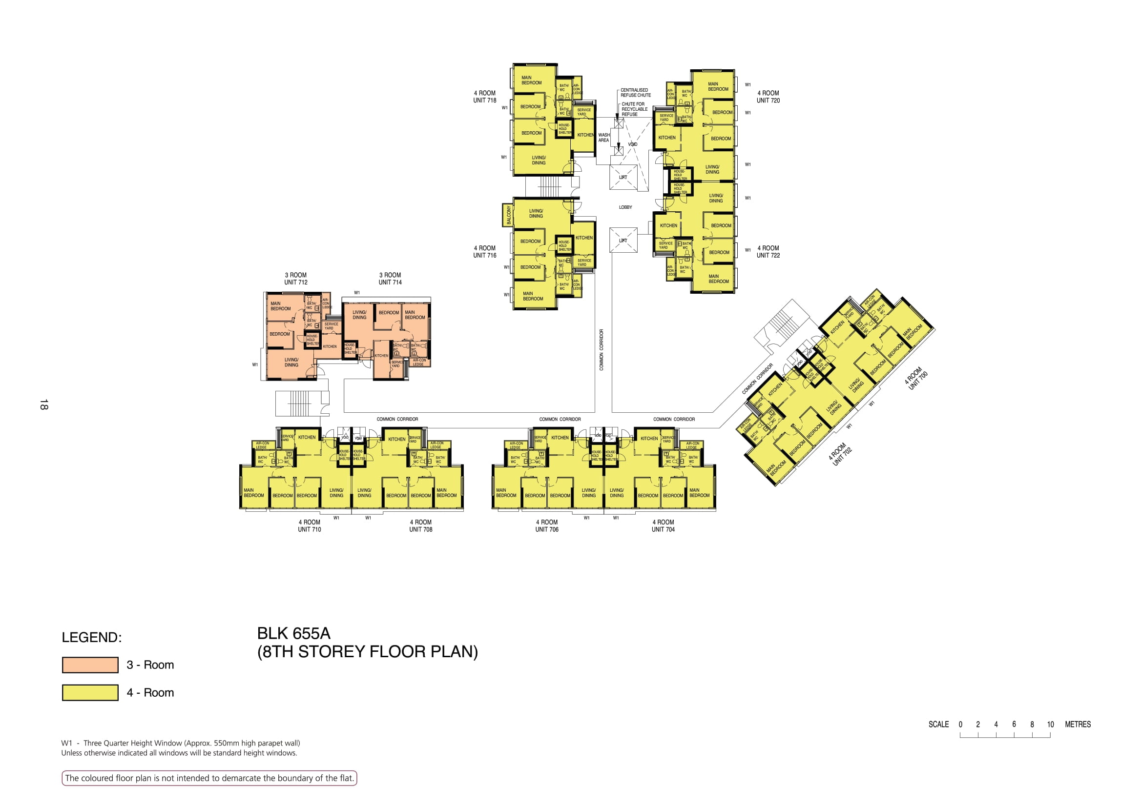

Slide 11
718
720
WASH AREA
LOBBY
716
722
712
714
COMMON CORRIDOR
700
COMMON CORRIDOR
COMMON CORRIDOR
COMMON CORRIDOR
702
710
708
706
704

Slide 12
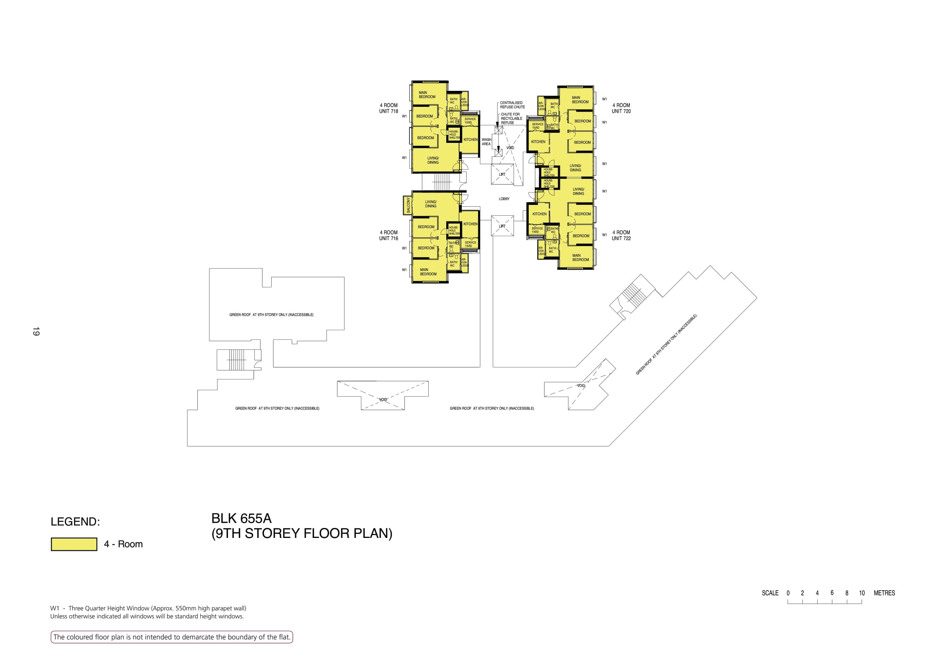

Slide 13
718
720
WASH AREA
LOBBY
716
722
COMMON CORRIDOR

Slide 14
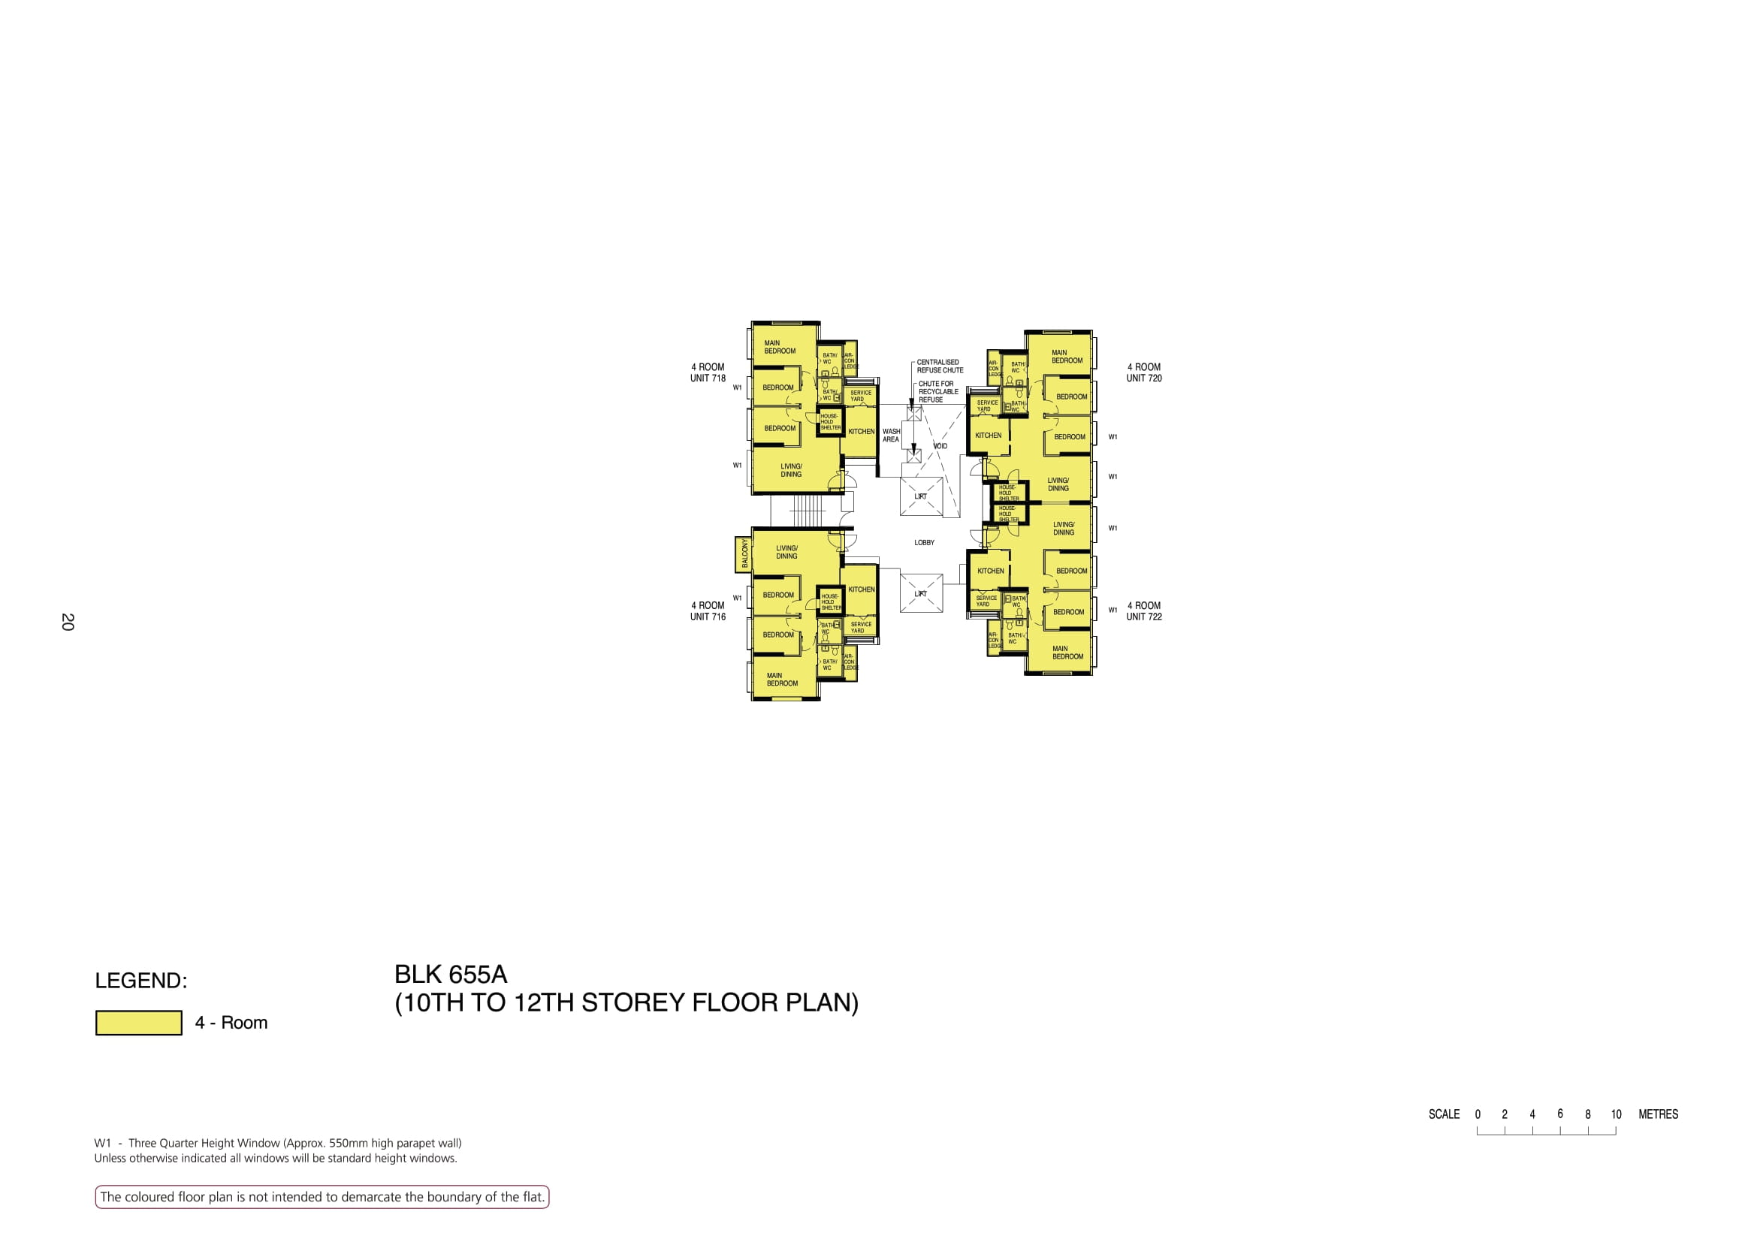

Slide 15
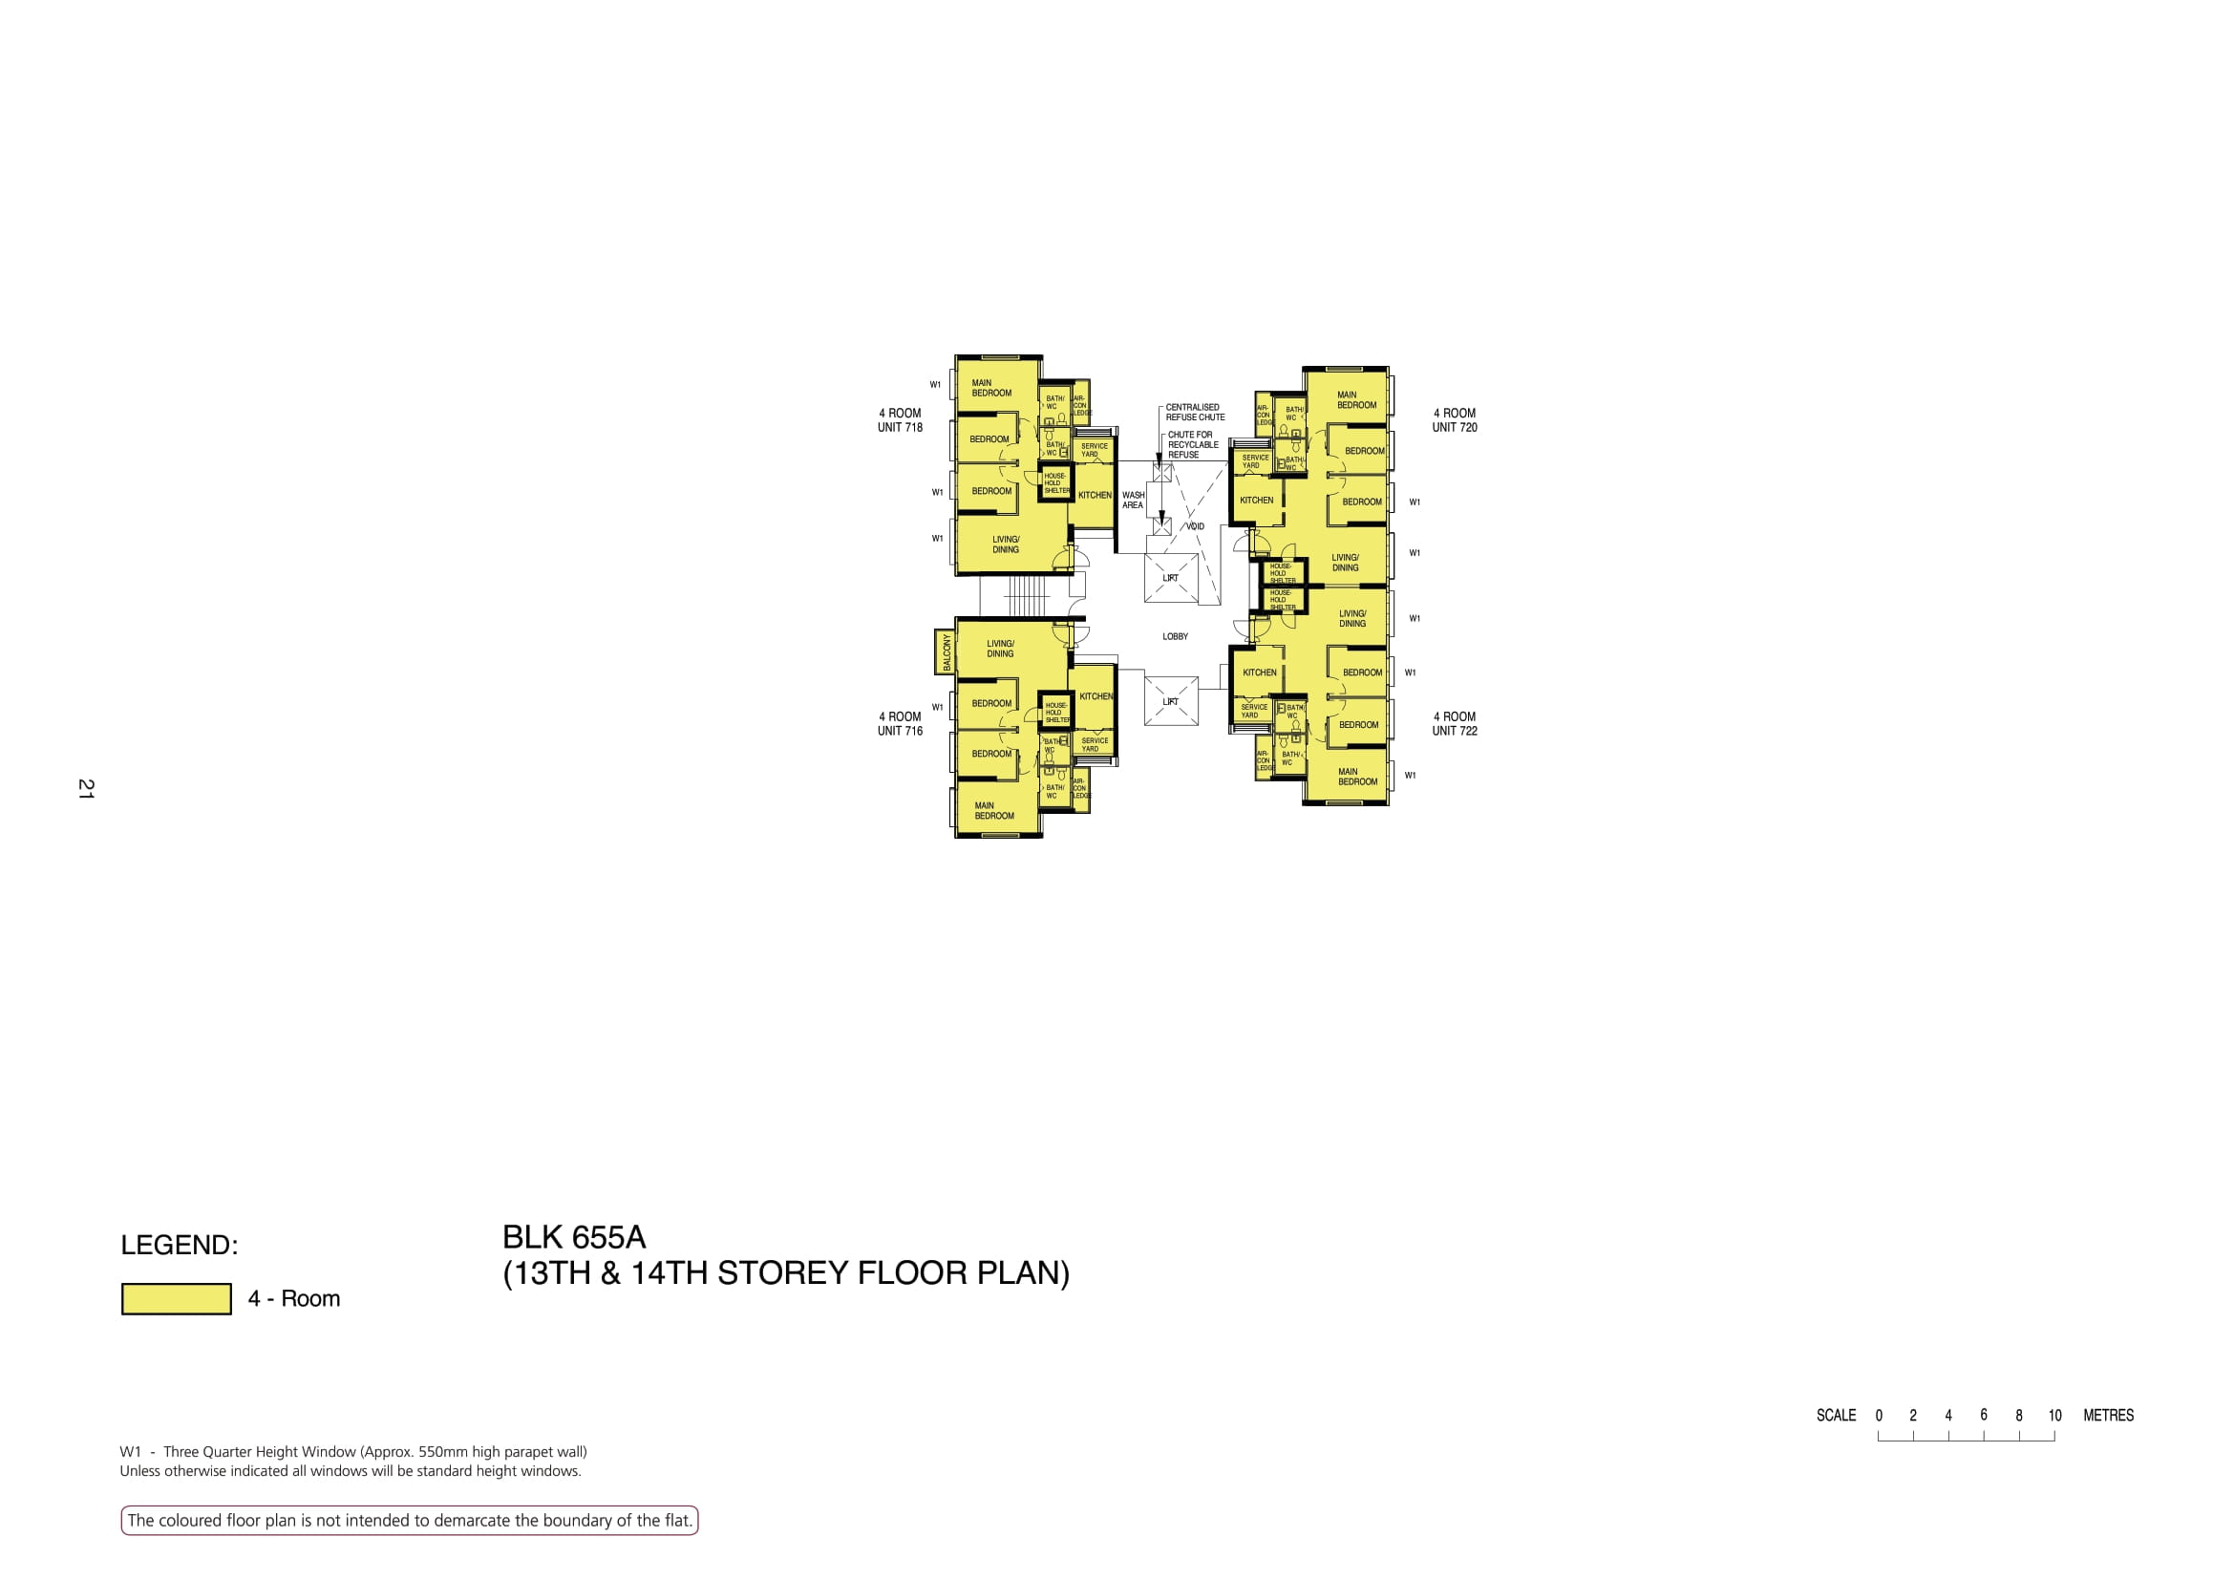

Slide 16
718
720
WASH AREA
LOBBY
716
722

